Slide 1

Effective Prompt Writing
Mastering Productivity Suite for Alternatives, Risk, Fund & ETF Operations

Slide 2

Meet Productivity Suite
Built upon the advanced reasoning capabilities of GPT-5, but securely fenced within our environment.
It combines world-class intelligence with secure access to our internal operational data, ensuring client confidentiality while delivering high-end automation.
To unlock its true potential, we must learn to speak its language.

Slide 3

Why Prompting Matters
"An AI is like an eager, brilliant, but literal-minded analyst. The quality and accuracy of its output depend entirely on the clarity of your instructions."
"
"
THE RULE OF AI OPERATIONS

Slide 4


The Prompt Shift
The Bad Prompt
The Good Prompt
"Summarize this risk report."
"Act as an expert Risk Analyst. Summarize the top 3 operational risks from this incident report in bullet points. The summary is for Senior Management review."
Why it fails:
• Too vague.
• Lacks format structure.
Why it succeeds:
• Ignores the target audience.
• Assigns a persona.
• Results in generic, unusable text.
• Specifies exact deliverables.
• Considers the final audience.

Slide 5
The COSTAR Framework
A structured, repeatable approach to writing deterministic, high-quality prompts that eliminate guesswork.

Slide 6









Structuring the Input
Context
Objective
Style
Provide necessary background information.
State exactly what the task is.
Specify the writing style or persona.
"Extract the management fee structures and flag any non-standard clauses..."
"Write in a professional, objective, and analytical financial tone..."
"We are evaluating a new Alternative Investment fund for onboarding..."

Slide 7








Shaping the Output
Tone
Audience
Response
Set the emotional resonance.
Define who will read this.
Dictate the exact format required.
"Keep the tone urgent but neutral, avoiding overly dramatic language..."
"This is being prepared for the Global Head of Fund Operations..."
"Present the findings in a 2-column markdown table format..."

Slide 8

Interactive Demo Time
Let's Build Together
3
We will apply COSTAR live in Productivity Suite to solve real daily challenges:
1. ETF Rebalancing Impact Summaries.
Live Scenarios
2. Operational Risk Incident Triage.
3. Fund Performance Commentary Drafts.

Slide 9
Advanced Pro-Tips
Iterative Prompting Don't settle for the first output. Ask the AI to refine itself: "This is good, but make the second section more concise and focus heavily on liquidity risk."
Few-Shot Prompting Show, don't just tell. If you want a specific output style, provide 1 or 2 examples of what "good" looks like inside your prompt before asking it to process new data.
Chain of Thought For complex data reconciliations, add the phrase: "Think step-by-step before providing your final answer." This drastically reduces logical errors.

Slide 10



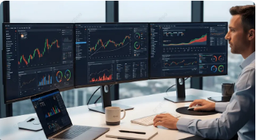


Real-World Applications
Fund Services
Risk & Resilience
Alternatives Ops
Automating daily NAV variance explanations and parsing lengthy prospectus documents for compliance checks.
Rapidly triaging incident reports, summarizing audit trails, and drafting regulatory response templates.
Extracting key financial clauses and dates from unstructured Private Equity capital call notices instantly.

Slide 11
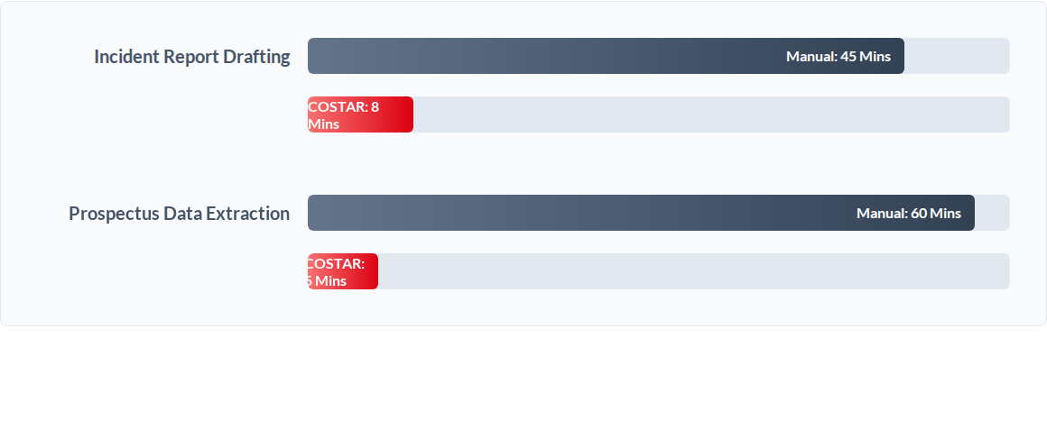
Efficiency Gains

Slide 12
Questions?
Let's draft some prompts for your specific workflows.
Asset Management Data Science Team

Slide 13




Image Sources
https://img.freepik.com/premium-photo/futuristic-blockchain-network-with-glowing-digital-nodes-representing-secure-data-connections_1294860-1016.jpg
Source: www.freepik.com
https://png.pngtree.com/thumb_back/fw800/background/20251125/pngtree-professional-man-analyzing-financial-data-on-multiple-monitors-in-a-modern-image_20588574.webp
Source: pngtree.com
https://static.vecteezy.com/system/resources/previews/071/520/934/non_2x/businessman-protecting-digital-bank-with-shield-secure-online-banking-concept-financial-security-data-protection-cyber-security-safeguarding-assets-risk-management-and-modern-technology-photo.jpg
Source: www.vecteezy.com
https://static.vecteezy.com/system/resources/previews/054/056/077/large_2x/business-team-collaborating-on-financial-reports-and-strategies-in-a-modern-office-setting-photo.jpg
Source: www.vecteezy.com

